Slide 1

USER MANUAL
FEMulator Pro

Slide 2
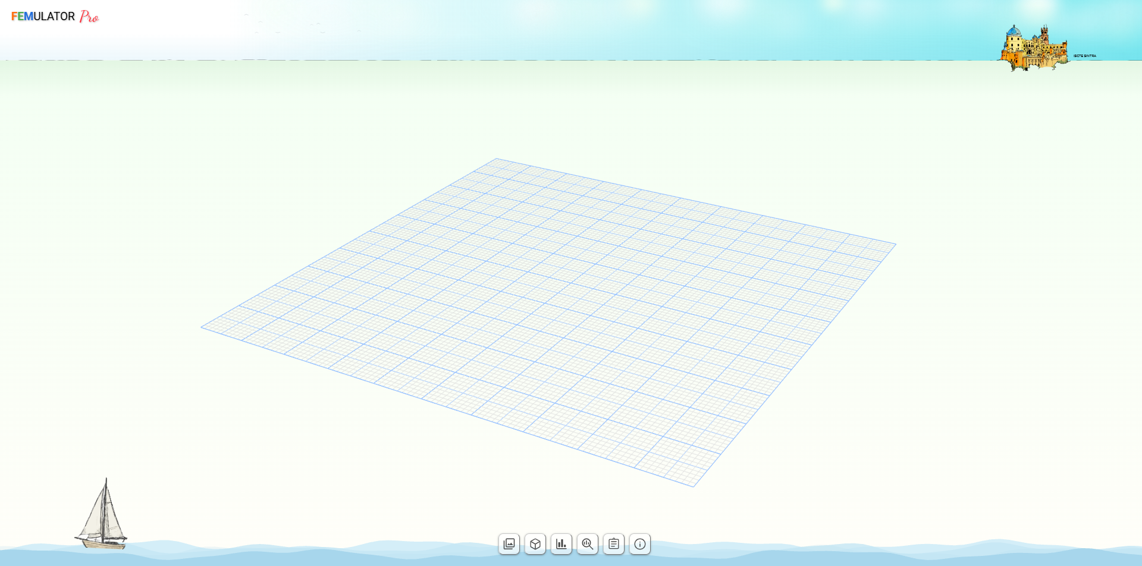
Control Buttons
1
Mesh Gallery
2
Simulation Details, Metrics & Settings
3
Benchmark & Simulations History
4
Profiling Sessions
1
2
3
4
5
6
5
Reporting
6
About

Slide 3
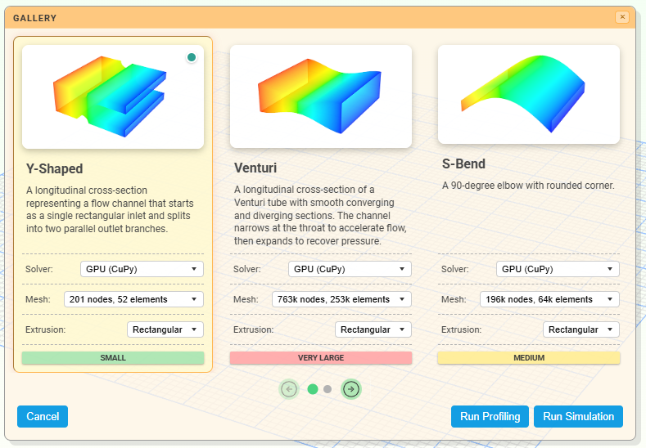
1 – Mesh Gallery

Slide 4
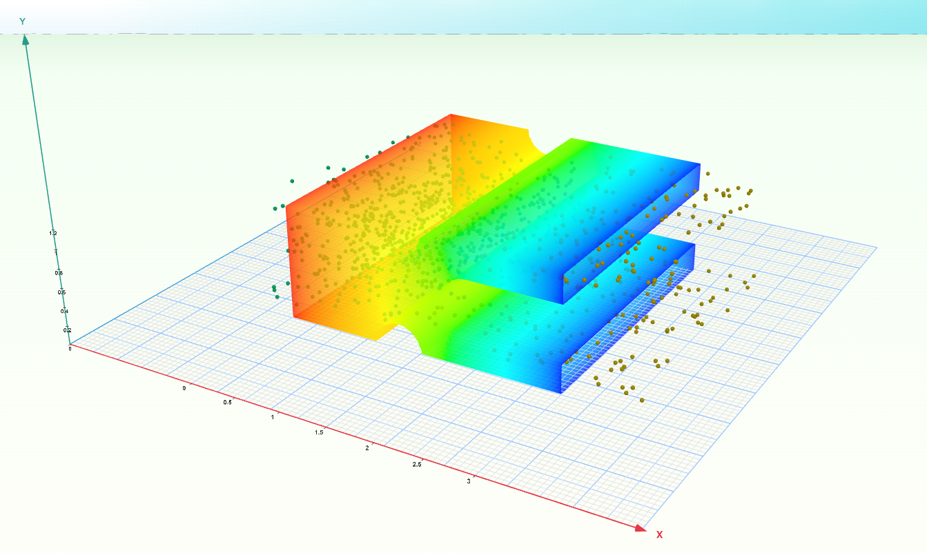
1 – Simulation

Slide 5
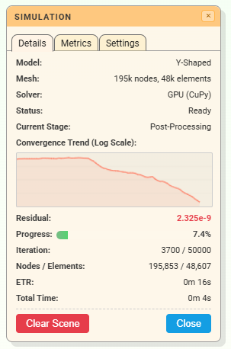
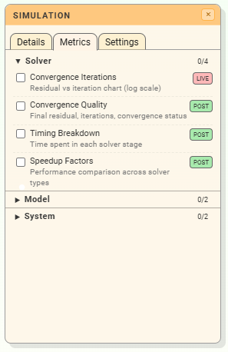
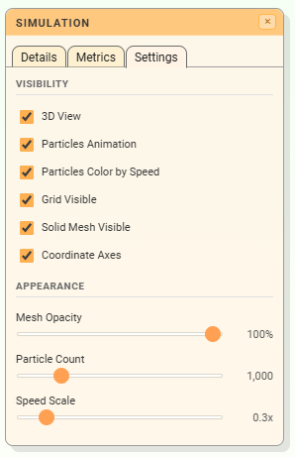
2 – Simulation Details, Metrics & Settings

Slide 6
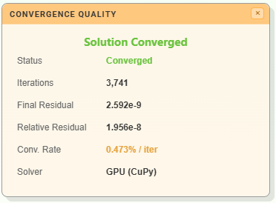
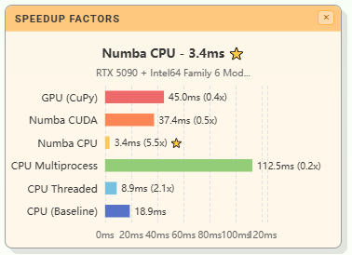
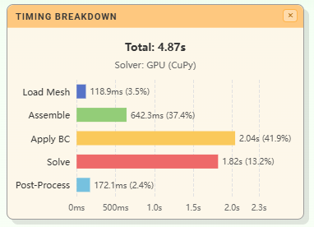
2 – Simulation Metrics - Examples

Slide 7
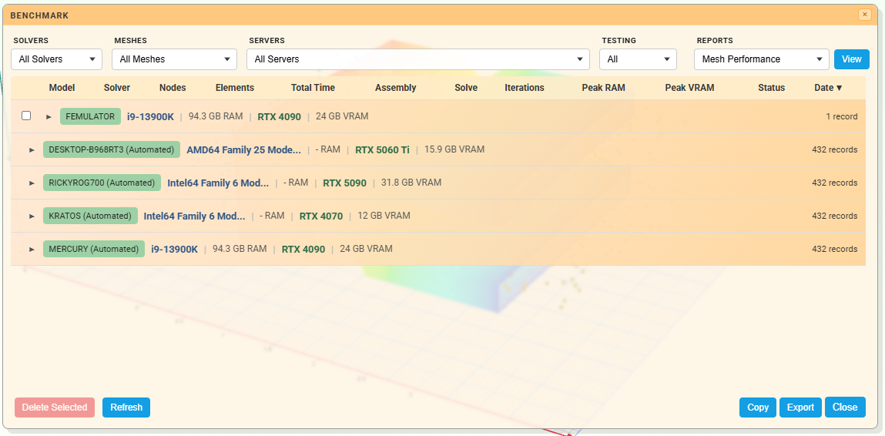
3 – Benchmark & Simulations History

Slide 8
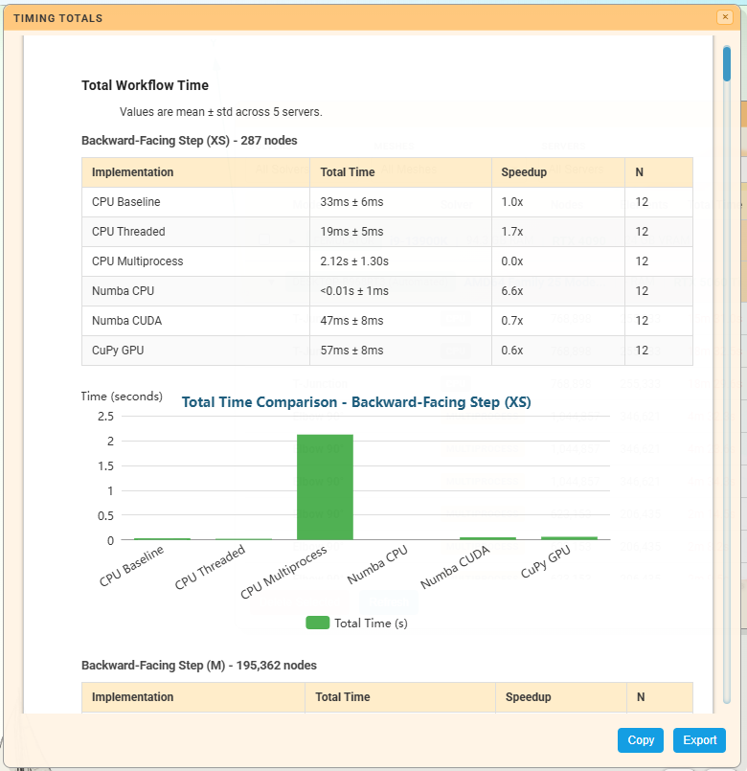
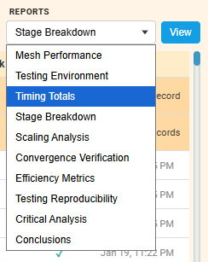
3 – Benchmark & Simulations History - Reports

Slide 9
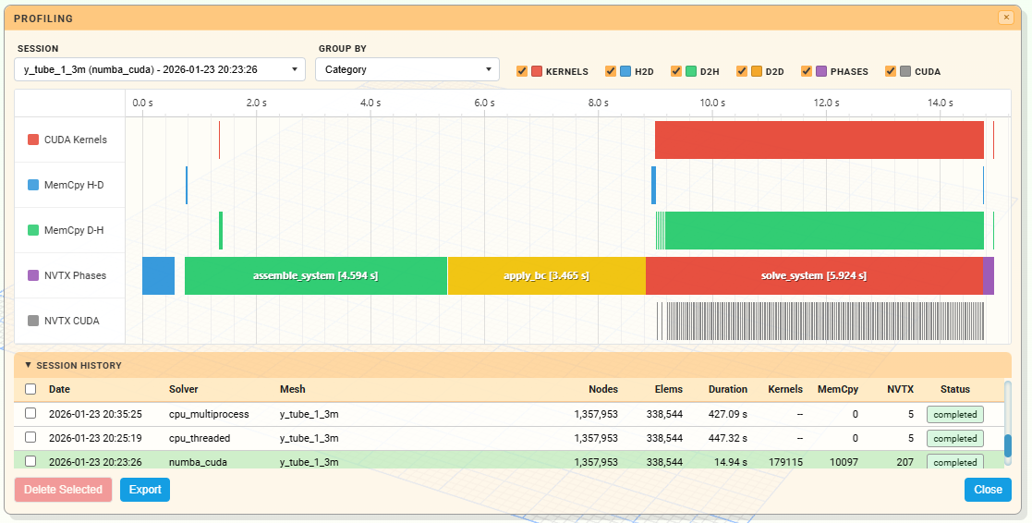
4 – Profiling Sessions

Slide 10
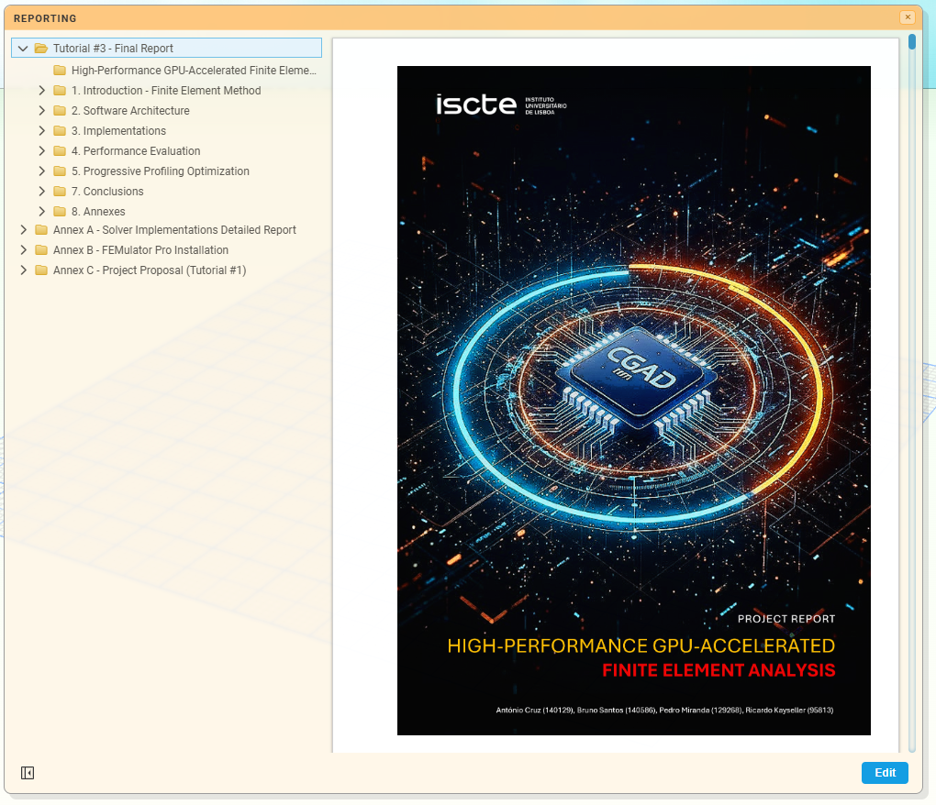
5 – Reporting

Slide 11
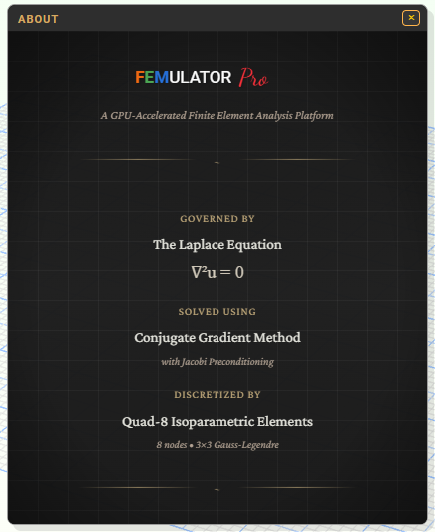
6 - About

